Slide 1
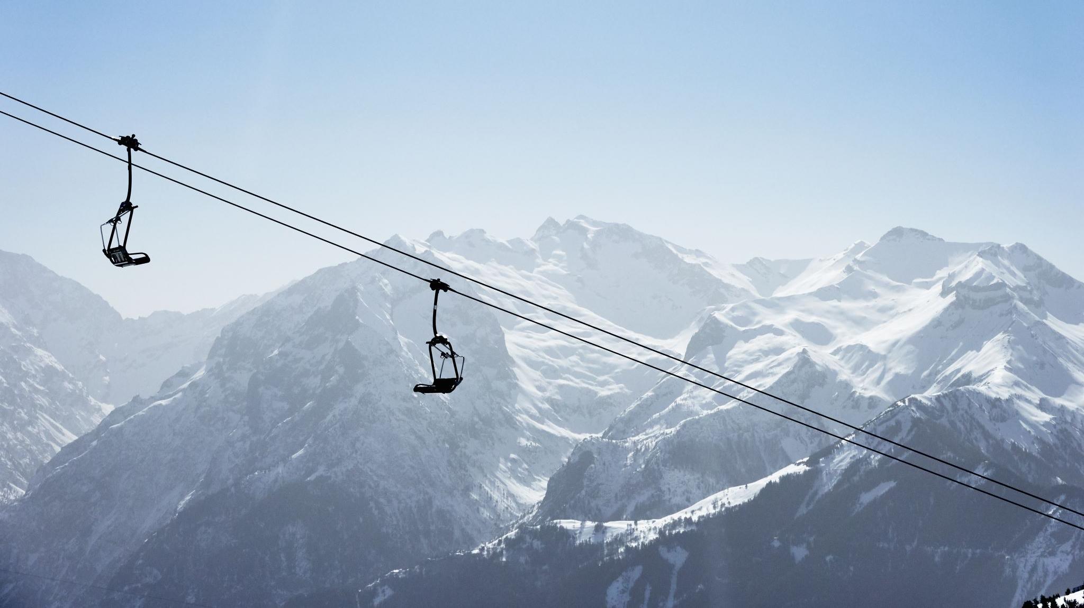
Big Mountain Resort
Executive Summary Report

Slide 2
Current Situation
Big Mountain Resort has recently installed an additional chair lift to help increase the distribution of visitors across the mountain. Unfortunately, this extra chair increases their operating costs by $1,540,000 over this upcoming ski season.
How can Big Mountain Resort adjust ticket pricing to take advantage of this improvement within its market?
Other considerations by Management to cut costs or
Permanently closing down up to 10 of the least used runs.
Increase the vertical drop by adding a run to a point 150 feet lower down but requiring the installation of an additional chair lift to bring skiers back up without additional snow-making coverage,
Having the same improvements as number 2 but adding 2 acres of snow making cover.
Increase the longest run by 0.2 miles to boast 3.5 miles length, requiring additional snow-making coverage of 4 acres.

Slide 3
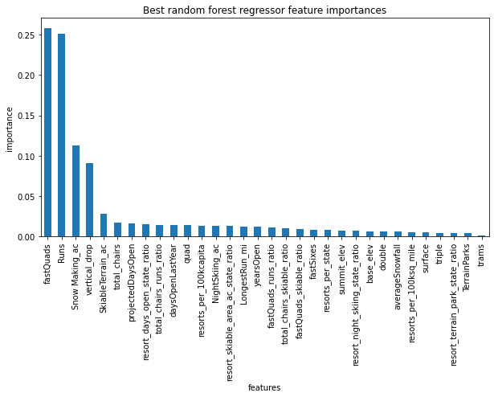
What are the most important features that customers will pay a premium for?
Modeling shows that the most important features that customers will pay a premium for are:
Fast Quads
Number of runs
Snowmaking per acreage
Vertical Drop

Slide 4
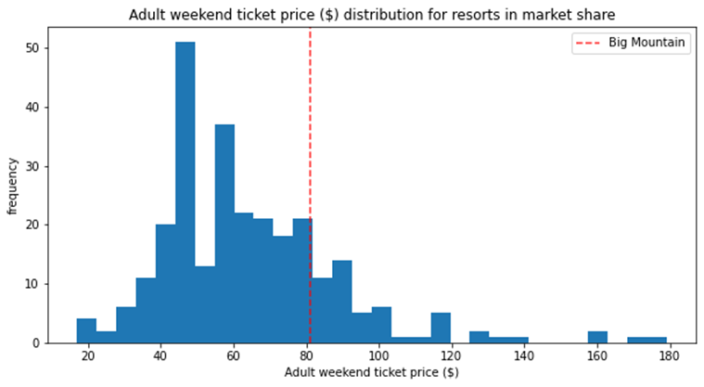
Modeled Pricing
Big Mountain Resort Adult Weekend Pricing is currently at $81
Based on the features which Big Mountain resort offers customers, the modeled pricing came out a $95.87

Slide 5
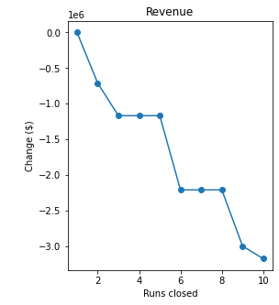
Could we drop runs to save costs?
Management is considering closing down of up to 10 of the least used runs in order to save costs.
Our analysis shows
Closing 1 had no impact
Closing 3-5 eroded ticket pricing
Closing 6 or more had serious impact on revenue

Slide 6
Adding extra snowmaking acreage and increasing run length
Other considerations
Increase the vertical drop by adding a run to a point 150 feet lower down but requiring the installation of an additional chair lift to bring skiers back up without additional snow-making coverage,
Having the same improvements as number 2 but adding 2 acres of snow making cover.
Increase the longest run by 0.2 miles to boast 3.5 miles length, requiring additional snow-making coverage of 4 acres.
The first consideration added an increased value to the ticket pricing of Big Mountain resort
The additional (2-3) added no value to ticket pricing.

Slide 7
Summary and Conclusion
Our final recommendation is for Big Mountain to add a run, increase the vertical drop by 150 feet, and install an additional chair lift.
Changing the Adult Weekend Pricing to the modeled amount.
Over the season, this could be expected to amount to $3,474,638 in additional revenue

